Slide 1
Employment Portal
Team 12
Kumar Abhishek Singh 12BCE1035
Pankul Garg 12BCE1009
Sukriti Singh 12BCE1100

Slide 2
Requirements
Frontend: HTML5, CSS3, JAVASCRIPT
Backend: PHP
Software:Notepad++ ,XAMPP

Slide 3
Algorithm
A user first has to sign-up as an employer or an job-seeker after singning in he has to first complete his profile and then continue to the welcome page.
A job-seeker can search for jobs based on his general experience in professional surroundings or his preference to a language.
After looking for a suitable job he can click to look for more details and then if interested can send his application to the employer.

Slide 4
Algorithm(continued)
The job-seeker, if interested, can follow a employer that is all the jobs posted by that particular employer will be available when the job-seeker clicks on the follow button.
The employer can post jobs after he logs in and view applications that are sent to the job. He can download the resume of the interested job-seeker and if interested he can shortlist that person by clicking the accept button which will inturn show a status shortlisted in the job-seekers account.

Slide 5
Work after review 2
All the relevant functionality has been added.
OTP verification and forgot password has been included.
Database connectivity has been implemented.

Slide 6
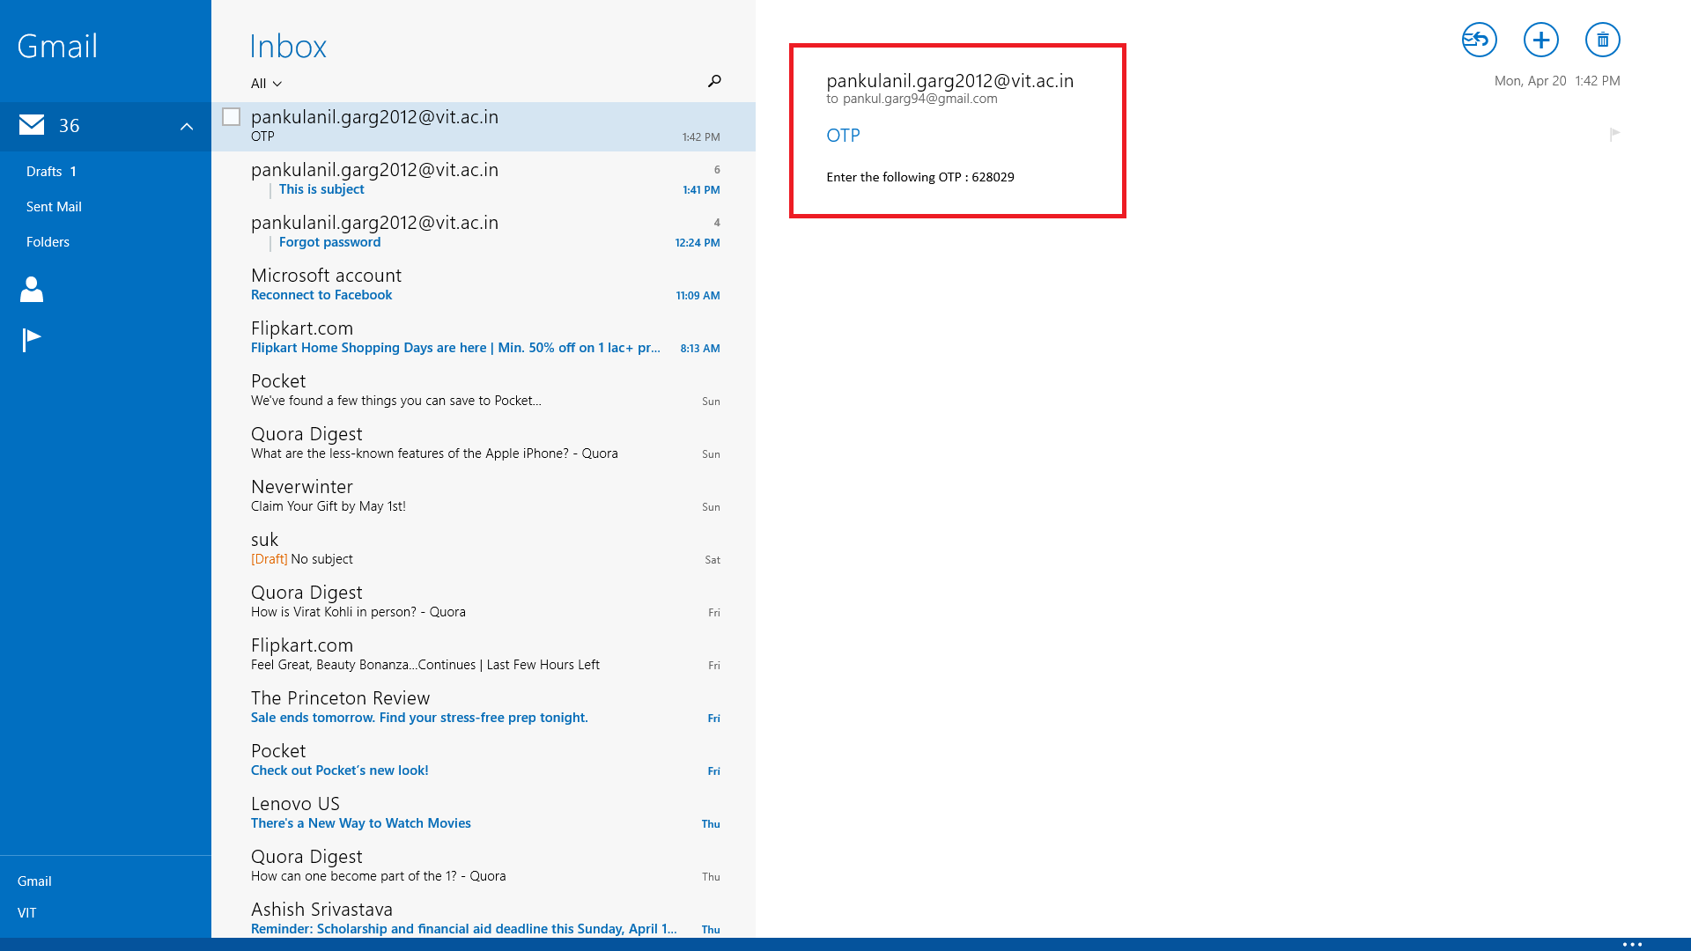
OTP Screenshot

Slide 7
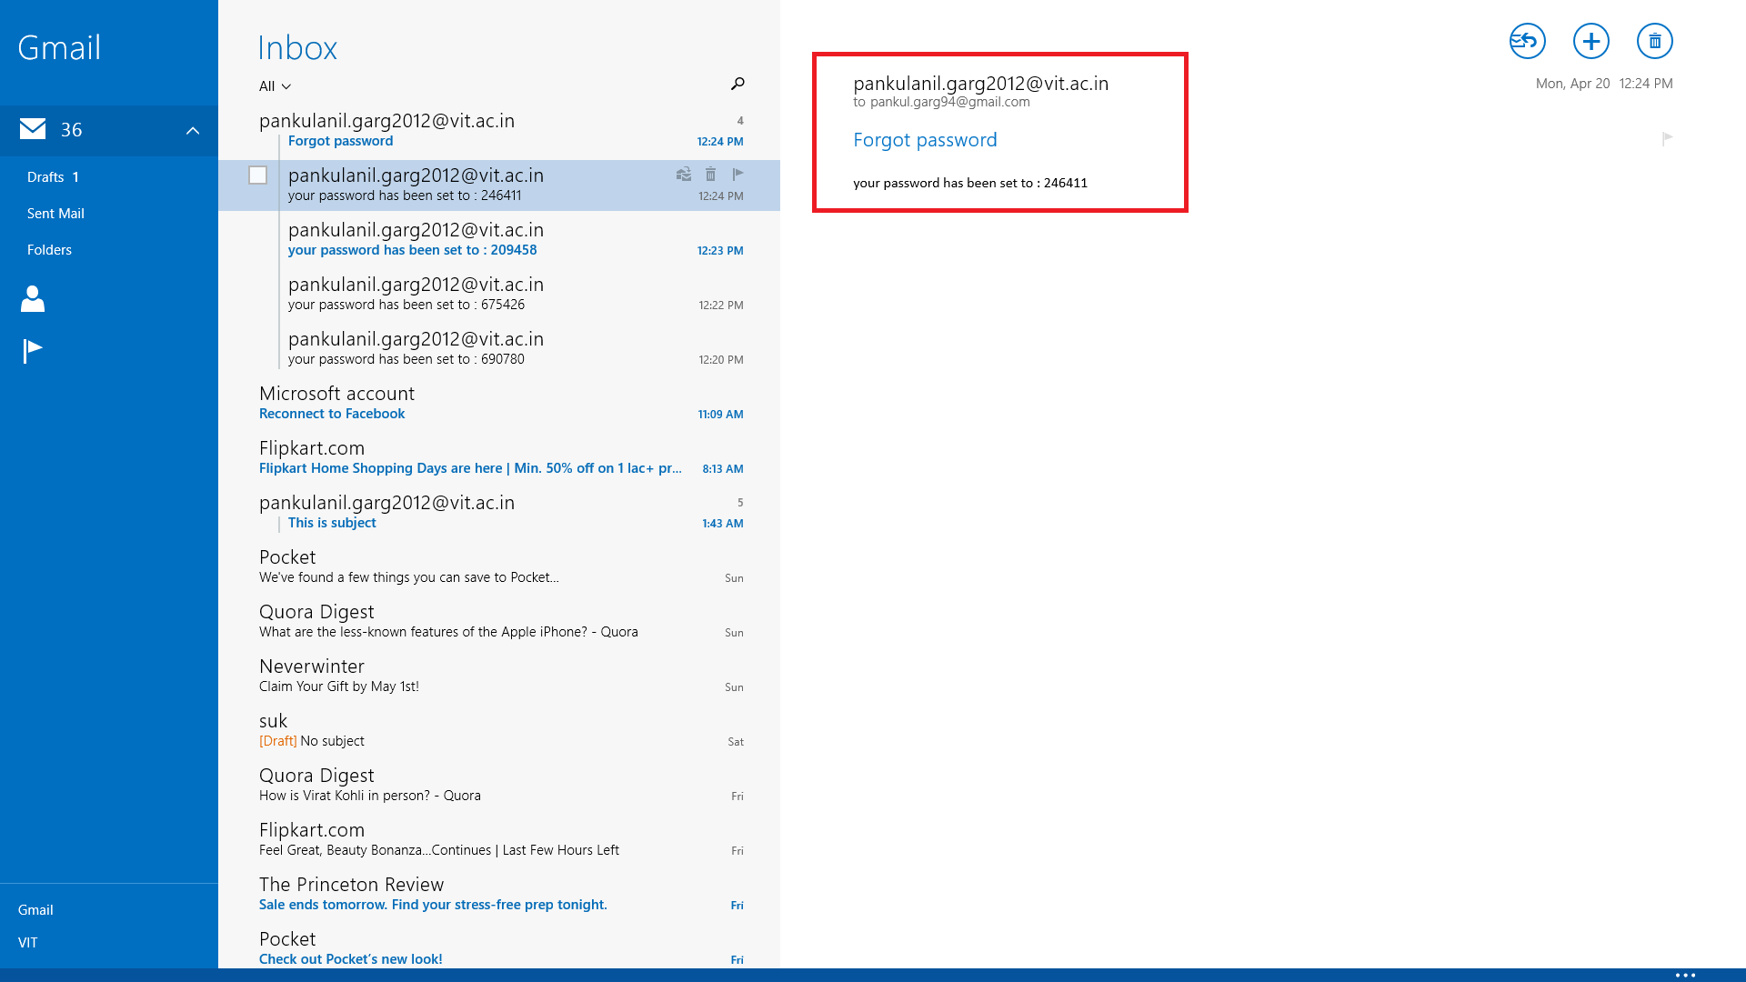
Forgot Password Screenshot

Slide 8
Applet Screenshot

Slide 9
References
HTML5 and CSS3 for absolute beginners –Channel 9
HTML and CSS for beginners – TutorialsPoint
Php.net/manual
W3schools.com
Bootswatch.com

